Slide 1


http://www.comp.nus.edu.sg/~cs2100/
Lecture #4c
Pointers and Functions

Slide 2
Questions?
IMPORTANT: DO NOT SCAN THE QR CODE IN THE VIDEO RECORDINGS. THEY NO LONGER WORK
Ask at
https://sets.netlify.app/module/676ca3a07d7f5ffc1741dc65
OR
Scan and ask your questions here! (May be obscured in some slides)

Slide 3
2. Calling Functions (1/3)
In C, there are many libraries offering functions for you to use.
Eg: scanf() and printf() – requires to include <stdio.h>
C provides many libraries, for example, the math library
To use math functions, you need to
Include <math.h> AND
Compile your program with –lm option (i.e. gcc –lm …) in sunfire
See table (next slide) for some math functions

Slide 4
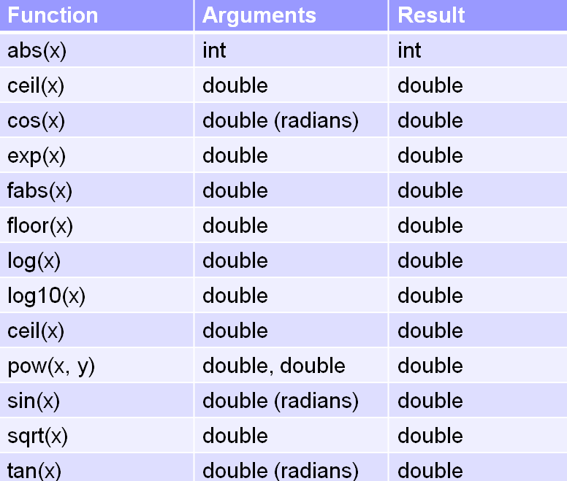
2. Calling Functions (2/3)
Function prototype:
double pow(double x, double y)
function return type

Slide 5
2. Calling Functions (3/3)
To link to Math library
MathFunctions.c
$ gcc –lm MathFunctions.c
$ a.out
Enter x and y:
#include <stdio.h>
#include <math.h>
int main(void) {
int x, y;
float val;
printf("Enter x and y: ");
scanf("%d %d", &x, &y);
printf("pow(%d, %d) = %f\n", x, y, pow(x,y));
printf("Enter value: ");
scanf("%f", &val);
printf("sqrt(%f) = %f\n", val, sqrt(val));
return 0;
}
3 4
pow(3,4) = 81.000000
Enter value:
65.4
sqrt(65.400002) = 8.087027

Slide 6
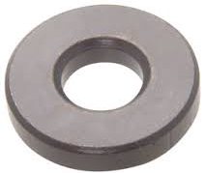
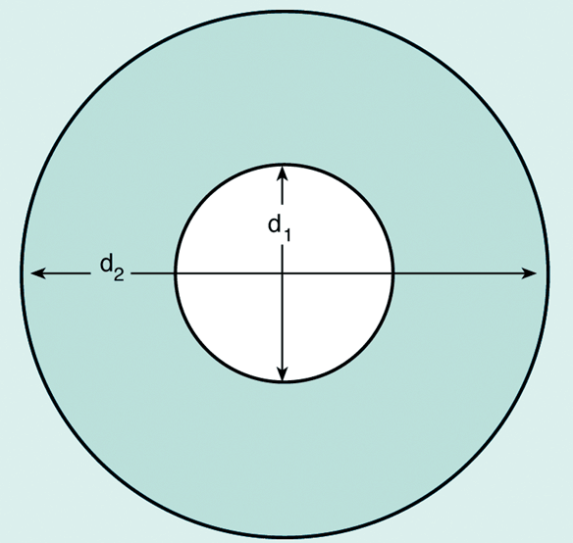
3. User-Defined Functions (1/6)
We can define and use our own functions
Example: Compute the volume of a flat washer. Dimensions of a flat washer are usually given as an inner diameter, an outer diameter, and a thickness.
rim area = π(d₂/2)² – π(d₁/2)²

Slide 7
3. User-Defined Functions (2/6)
Washer.c
#include <stdio.h>
#include <math.h>
#define PI 3.14159
int main(void) {
double d1, // inner diameter
d2, // outer diameter
thickness, outer_area, inner_area, rim_area, volume;
// read input data
printf("Enter inner diameter, outer diameter, thickness: ");
scanf("%lf %lf %lf", &d1, &d2, &thickness);
// compute volume of a washer
outer_area = PI * pow(d2/2, 2);
inner_area = PI * pow(d1/2, 2);
rim_area = outer_area - inner_area;
volume = rim_area * thickness;
printf("Volume of washer = %.2f\n", volume);
return 0;
}
Enter …: 8.2 10.5 2.2
Volume of washer = 74.32

Slide 8
3. User-Defined Functions (3/6)
Note that area of circle is computed twice. For code reusability, it is better to define a function to compute area of a circle.
double circle_area(double diameter) {
return PI * pow(diameter/2, 2);
}
We can then call/invoke this function whenever we need it.
circle_area(d2) → to compute area of circle with diameter d2
circle_area(d1) → to compute area of circle with diameter d1

Slide 9
3. User-Defined Functions (4/6)
WasherV2.c
#include <stdio.h>
#include <math.h>
#define PI 3.14159
double circle_area(double);
int main(void) {
// code similar to Washer.c; omitted here
// compute volume of a washer
rim_area = circle_area(d2) – circle_area(d1);
volume = rim_area * thickness;
printf("Volume of washer = %.2f\n", volume);
return 0;
}
// This function returns the area of a circle
double circle_area(double diameter) {
return PI * pow(diameter/2, 2);
}
Function prototype
Function definition

Slide 10
3. User-Defined Functions (5/6)
It is a good practice to put function prototypes at the top of the program, before the main() function, to inform the compiler of the functions that your program may use and their return types and parameter types.
A function prototype includes only the function’s return type, the function’s name, and the data types of the parameters (names of parameters are optional).
Function definitions to follow after the main() function.
Without function prototypes, you will get error/warning messages from the compiler.

Slide 11
3. User-Defined Functions (6/6)
Let’s remove (or comment off) the function prototype for circle_area() in WashersV2.c
Messages from compiler:
WashersV2.c: In function ‘main’:
WashersV2.c:19:2: warning: implicit declaration of function ‘circle_area’ [-Wimplicit-function-declaration]
rim_area = circle_area(d2) – circle_area(d1);
^
WasherV2.c: At top level:
WashersV2.c:27:8: error: conflicting types for ‘circle-area’
:
Without function prototype, compiler assumes the default (implicit) return type of int for circle_area() when the function is used in line 19, which conflicts with the function header of circle_area() when the compiler encounters the function definition later in line 27.

Slide 12
End of File

